Slide 1
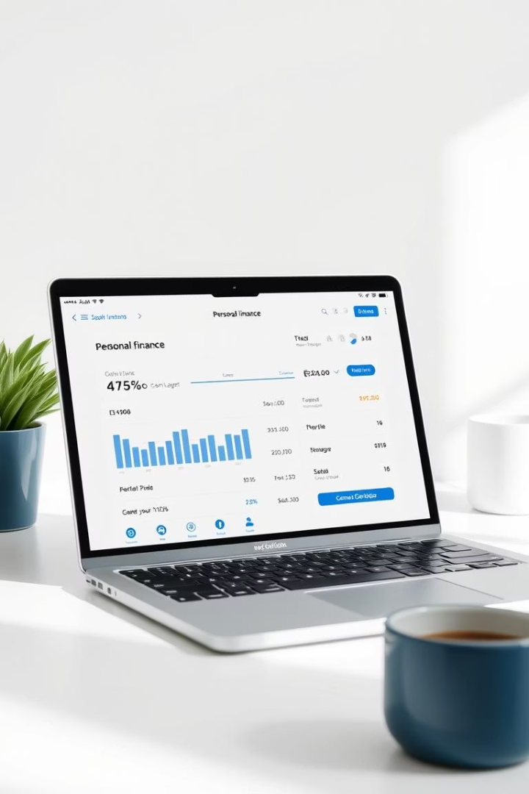
Self Finance Tracker
Track your income, expenses, and investments easily
Presented by: Your Name | Date: April 18, 2025

Slide 2

Project Overview
Web-based Tracker
User-Friendly Design
Manage personal finances anywhere
Simple interface for all skill levels
Core Technologies
HTML, CSS, JavaScript

Slide 3
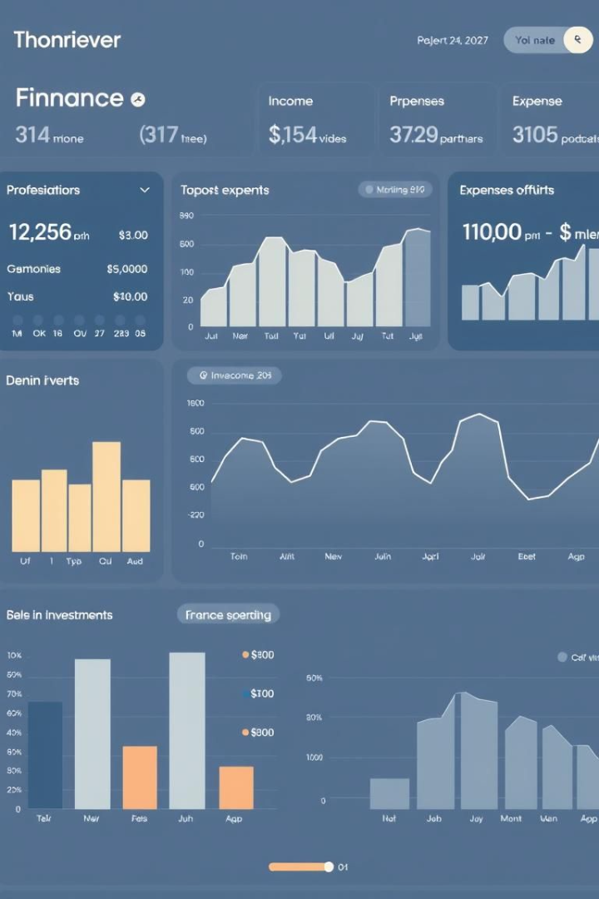
Key Features
Income Tracking
Add and monitor your earnings
Expense Management
Record and categorize expenditures
Real-Time Balance
Instant financial overview
Investment Ideas
Diversified smart options

Slide 4
Home Page Screenshot
Header
Content Sections
Buttons
App title prominently displayed
Income, Expenses, and Distribution panels
Clear call-to-action for easy navigation

Slide 5
Expense Distribution & Balance
Visual Charts
Real-Time Balance
Financial Health
Intuitive expense distribution
Instant updates on finances
Easy tracking for informed decisions

Slide 6
Investment Ideas
Mutual Funds
Stocks
Recurring Deposits
Gold/Silver
Emergency Fund
Educates users on diversified saving options

Slide 7

Technologies Used
HTML
Structure
CSS
Styling
JavaScript
Interactivity & data handling
Local Storage
Data persistence

Slide 8

Learnings & Challenges
DOM Manipulation
UI/UX Design
Dynamic Content
Debugging & Responsiveness

Slide 9

Conclusion
Simple & Functional
Clean UI
Accessible for all users
Easy navigation and clarity
Future Scope
Graphs, exports, analytics planned

Slide 10

Thank You
Any Questions? Contact: your email or GitHub

